Slide 1
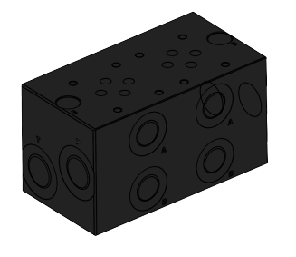
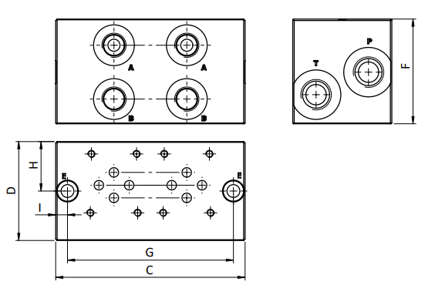
Winman NG6 HİDROLİK BLOK SERİSİ
Winman NG6 HYDRAULIC BLOCK SERIES
Teknik Çizim / Technical Drawing
Sipariş Kodu / Ordering Code
Ürün Modelİ | A | B | C (mm) | D (mm) | E (Ø) | F (mm) | G (mm) | H (mm) | I (mm) | P | T
2 STATION | G 3/8’’ | G 3/8’’ | 130 | 68 | 9 | 72 | 113.9 | 34 | 8.1 | G 1/2’’ | G 1/2’’
3 STATION | G 3/8’’ | G 3/8’’ | 180 | 68 | 9 | 72 | 163.9 | 34 | 8.1 | G 1/2’’ | G 1/2’’
4 STATION | G 3/8’’ | G 3/8’’ | 230 | 68 | 9 | 72 | 213.9 | 34 | 8.1 | G 1/2’’ | G 1/2’’
5 STATION | G 3/8’’ | G 3/8’’ | 287 | 76.5 | 9 | 72 | 266 | 37.5 | 11 | G 1/2’’ | G 1/2’’
6 STATION | G 3/8’’ | G 3/8’’ | 330 | 68 | 9 | 72 | 313.9 | 34 | 8.1 | G 1/2’’ | G 1/2’’
7 STATION | G 3/8’’ | G 3/8’’ | 380 | 68 | 9 | 72 | 363.9 | 34 | 8.1 | G 1/2’’ | G 1/2’’
8 STATION | G 3/8’’ | G 3/8’’ | 430 | 68 | 9 | 72 | 413.9 | 34 | 8.1 | G 1/2’’ | G 1/2’’
9 STATION | G 3/8’’ | G 3/8’’ | 480 | 68 | 9 | 72 | 463.9 | 34 | 8.1 | G 1/2’’ | G 1/2’’
10 STATION | G 3/8’’ | G 3/8’’ | 535 | 76.5 | 9 | 69 | 515 | 37.5 | 11 | G 1/2’’ | G 1/2’’

